Slide 1

FCPS - Waste Cost Management
By Varun Gholap and Neeraj Magdum

Slide 2


The Challenge: Food Waste in School Nutrition
Understanding the Scale
Our analysis covers 188,856 meal production records from 187 Fairfax County Public Schools
The average leftover rate sits at 18.4%, though the median is notably lower at 5%.
Current menu planning remains manual and static
~$29K worth of food discarded across 187 schools — a significant opportunity for adaptive, data-driven menu optimization.

Slide 3
Project Goals
Data-Driven Framework
Pattern Recognition
Analyze meal production, serving, and waste trends across all 187 schools
Identify high-waste menu items and their contextual factors including school_name , day of week, meal type, and production cost.
01
02
Implement Contextual Bandits
Continuous Learning
Deploy LinUCB algorithms to recommend optimal meal combinations based on real-world performance data.
Update recommendations based on school and waste feedback from each service period.
03
Sustainable Planning
Support FCPS sustainability goals to reduce $29K in waste identified in sample data.

Slide 4

Understanding LinUCB
What is LinUCB?
Linear Upper Confidence Bound (LinUCB) is a contextual bandit algorithm designed for adaptive decision-making in uncertain environments.
It elegantly balances two critical objectives:
Exploration: Testing new options to gather learning data
Exploitation: Selecting options with proven performance
The Core Formula
r = θᵀx + ε
r = expected reward (success, satisfaction, performance)
x = feature vector (contextual characteristics)
θ = model parameters learned over time
ε = prediction error

Slide 5



LinUCB in Action: FCPS Meal Optimization
System Architecture
Arms
Rounds
Each unique dish is an "arm" the model can choose.
A "round" is a day, school, and meal type combination.
Key Context Features
Planned_Total, Served_Total
Production_Cost_Total, Discarded_Cost, Left_Over_Cost
DayOfMonth, Month
One-hot encoded Meal_Type categories
The model continuously tracks diagnostic metrics including reward, regret, uncertainty, θ-change (Δθ), and exploration ratio to monitor its balance of exploration versus exploitation.
Building the X Matrix: Example Round
Consider a round: Breakfast at "GWU" on October 22, 2025, where only "Apple" and "Banana" were served.
Available dishes: "Apple" and "Banana" feature vectors (e.g., [100, 80, 1]) are included.
Unavailable dishes: For dishes like "Chicken" or "Salad" not served in this round, zero-vector placeholders ([0, 0, 0]) are created.
This approach ensures consistent matrix dimensionality across all rounds, clearly indicating which arms were available for selection in each context.

Slide 6
LinUCB Decision Flow: Step-by-Step
Initialization
1
A (identity matrix), b=0 for each arm (dish).
2
Arm Selection
The arm (dish) with the highest p_i (upper confidence bound) is chosen. This selection balances known performance with exploration of new options.
Reward Computation
3
Served / Planned
4
Model Update
After observing the reward, the model parameters are refined

Slide 7
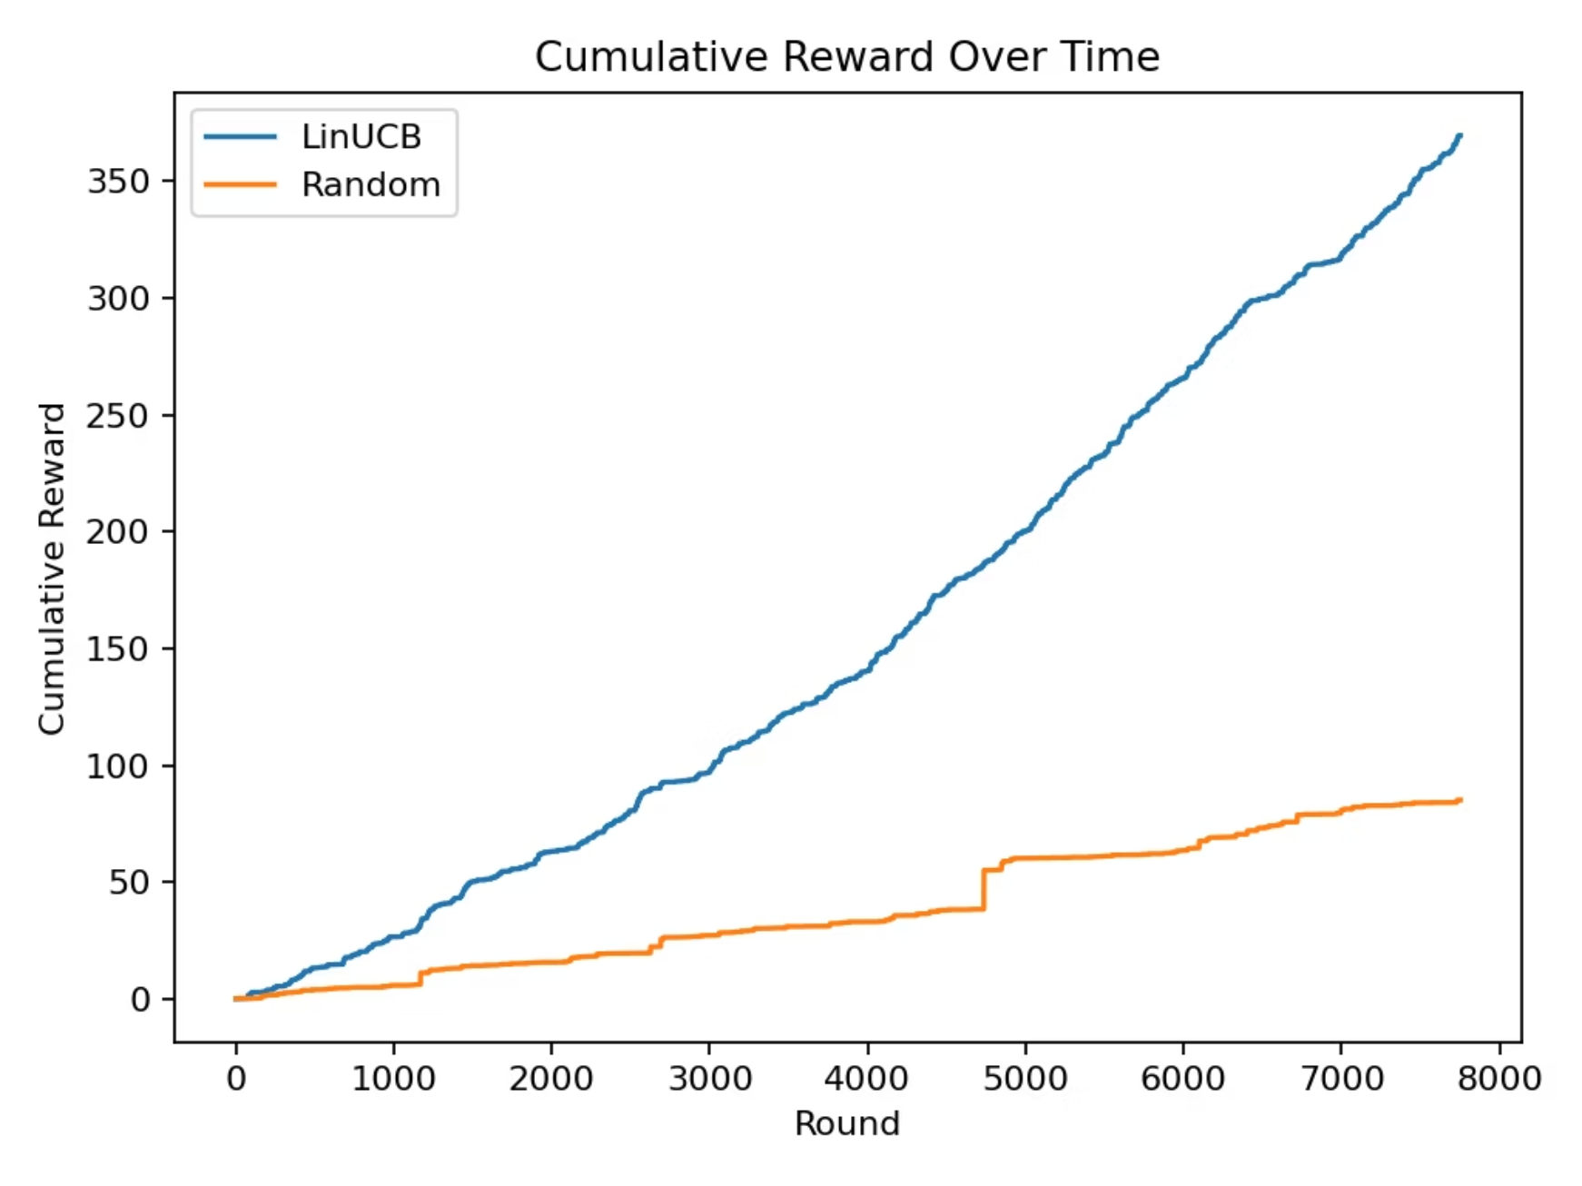
Performance: Cumulative Reward Over Time

Slide 8
Key Findings & Impact
4x Performance Gain: LinUCB achieved 369.57 cumulative reward vs. 90.44 random baseline
Real-World Data Handling: Successfully processed 321 unique dishes from messy operational dataset
Rapid Convergence: Model stabilized quickly with sharp uncertainty reduction in early rounds

Slide 9
Thank you

